Slide 1
Document Retrieval Models
Probabilistic, Non-Overlapping List, and Proximal Nodes Models
Khadim Hussain 2021-cs-204

Slide 2
Objective
To build a Document Retrieval System that allows users to search for relevant documents using:
Probabilistic Model (Binary Independence Model - BIM)
Non-Overlapping List Model
Proximal Nodes Model

Slide 3
Binary Independence Model (BIM)
The Binary Independence Model (BIM) is a probabilistic information retrieval model.
It treats each term in a document as independent and assigns binary weights (1 if present, 0 if absent).
BIM uses similarity measures such as Jaccard or Dice coefficients to rank documents.

Slide 4
Real-Life Example of BIM
For example, a library system might use BIM to rank books based on how many terms in the user's query match the terms in the books.
A query about 'machine learning' might rank books containing those specific terms.

Slide 5
Non-Overlapping List Model
The Non-Overlapping List Model combines documents from different sets, where each set corresponds to a specific term or keyword.
The results are merged using a set union, ensuring that documents from different terms do not overlap.

Slide 6


Real-Life Example of Non-Overlapping List
For example, if a user searches for 'machine learning' and 'data visualization,' the system retrieves documents that are related to either 'machine learning' or 'data visualization,' but without any overlap.

Slide 7
Proximal Nodes Model
The Proximal Nodes Model uses a network of interconnected entities, such as documents and terms.
It retrieves documents connected to 'proximal nodes' or entities, based on relationships or proximity in the network.

Slide 8

Real-Life Example of Proximal Nodes
For example, if a user searches for 'space exploration,' the system may use proximal nodes like 'NASA' or 'astronauts' to find documents related to these nodes, such as articles on NASA missions or astronauts in space.

Slide 9
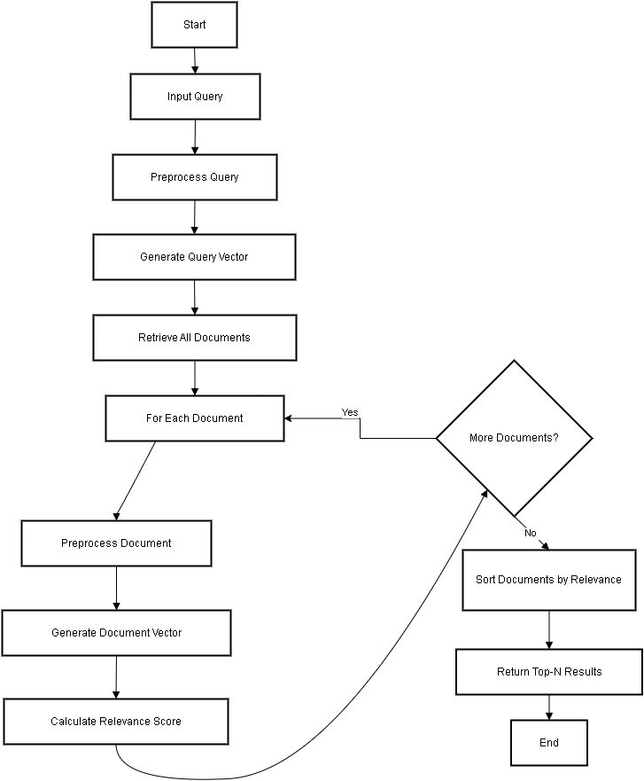
BIM Code Flow

Slide 10
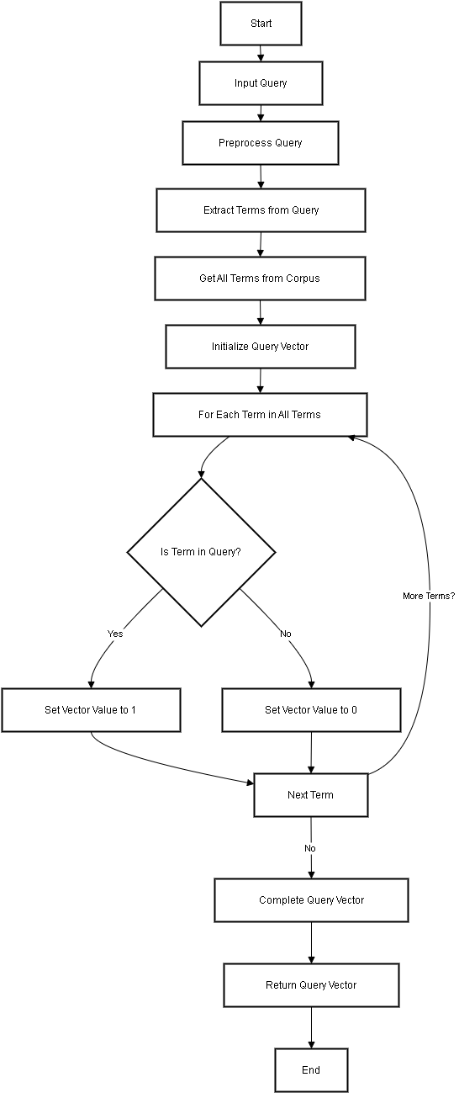
BIM Code Flow Query Vector Generation

Slide 11
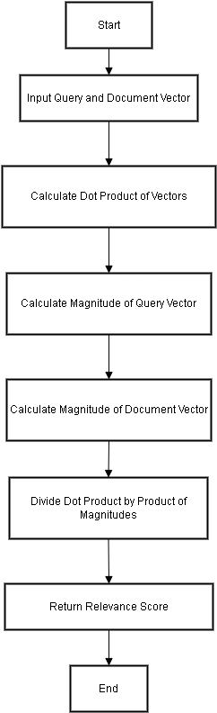
BIM Code Flow Calculating Relevance

Slide 12
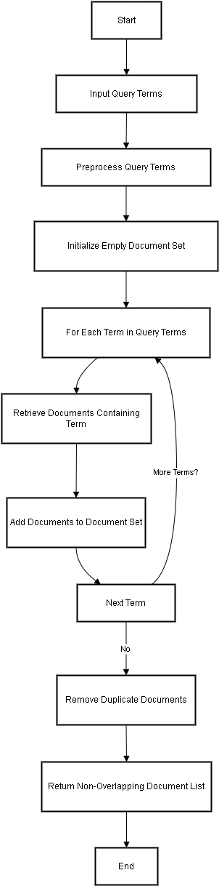
Non-Overlapping List Code Flow
def get_non_overlapping_documents(terms):
combined_documents = set()
for term in terms:
documents_for_term = get_documents_by_term(term)
combined_documents.update(documents_for_term)
return list(combined_documents)

Slide 13
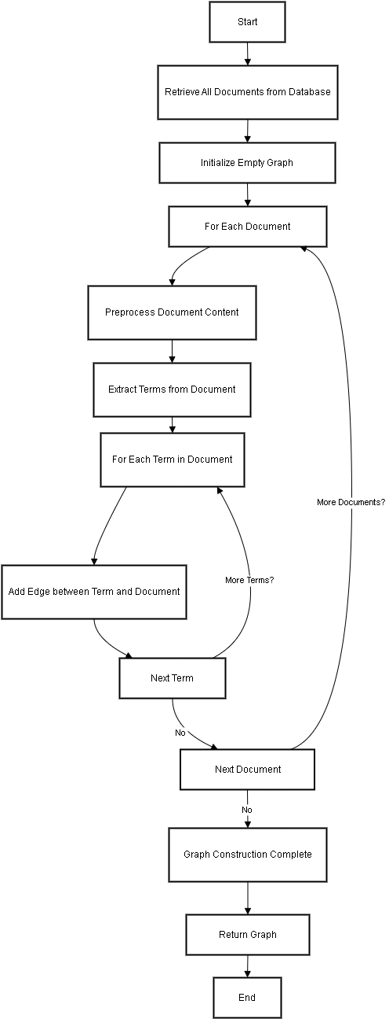
Proximal Nodes Code Flow
def preprocess_and_build_graph():
for doc in Document.objects.all():
content_terms = preprocess_text(doc.content)
for term in content_terms:
document_graph.add_edge(term, doc)

Slide 14
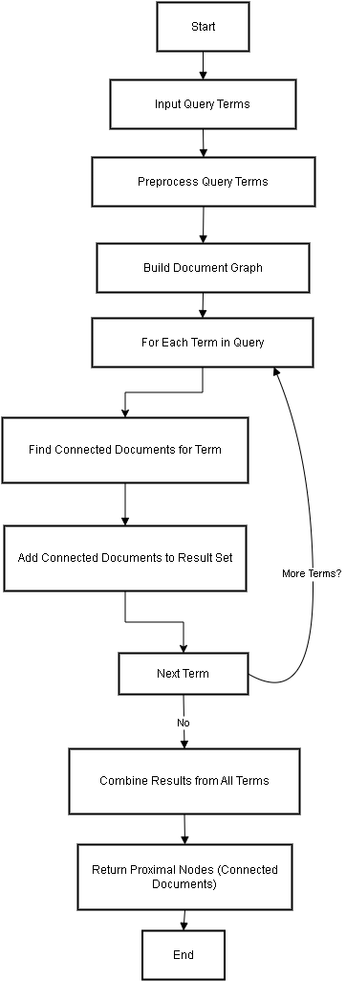
Proximal Nodes Code Flow
def get_connected_documents(self, terms):
connected_documents = set()
for term in terms:
if term in self.graph:
connected_documents.update(self.graph[term])
return list(connected_documents)

Slide 15
Conclusion
1. Probabilistic Model: Uses binary vectors and cosine similarity.
2. Non-Overlapped List Model: Combines results for multiple terms.
3. Proximal Nodes Model: Leverages graph relationships for retrieval.

